Slide 1
Introduction
Overall 9 + Years Industry Experience
Senior Solution Architect (Azure Solution Architect)
Machine Learning Engineer
Senior Software Developer → Full Stack .NET Developer
Domain Expertise ->
Banking, E-Commerce. HealthCare, Aviation
Presented By : Abhishek Panda

Slide 2
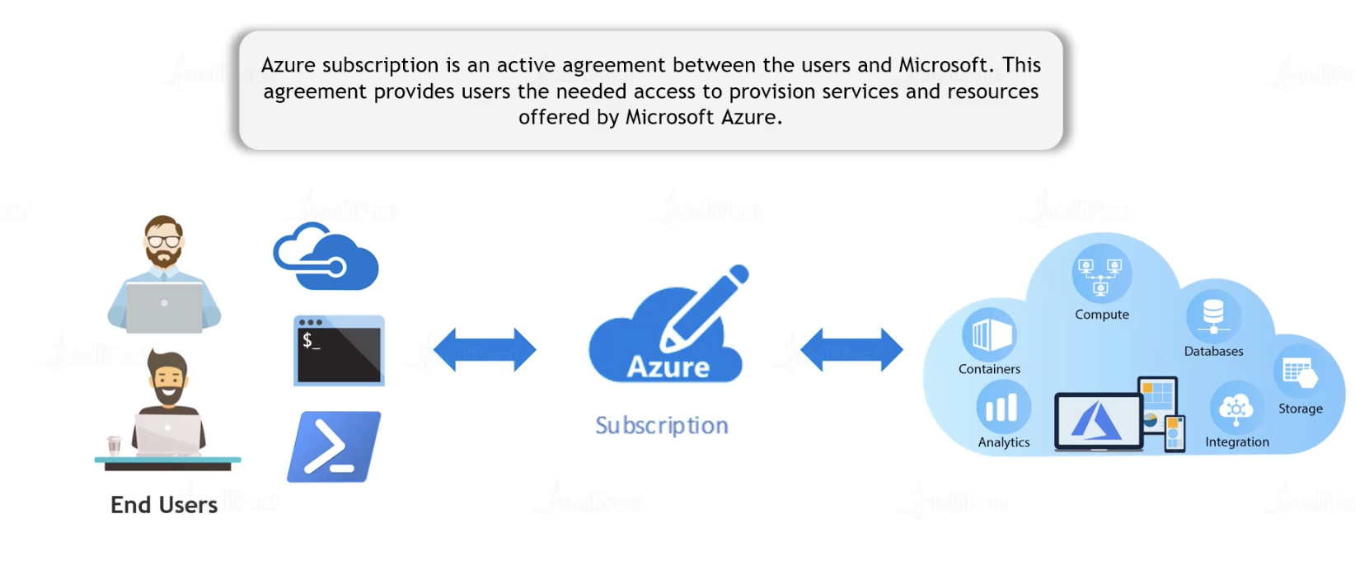
Azure Subscription
Created By : Abhishek Panda

Slide 3
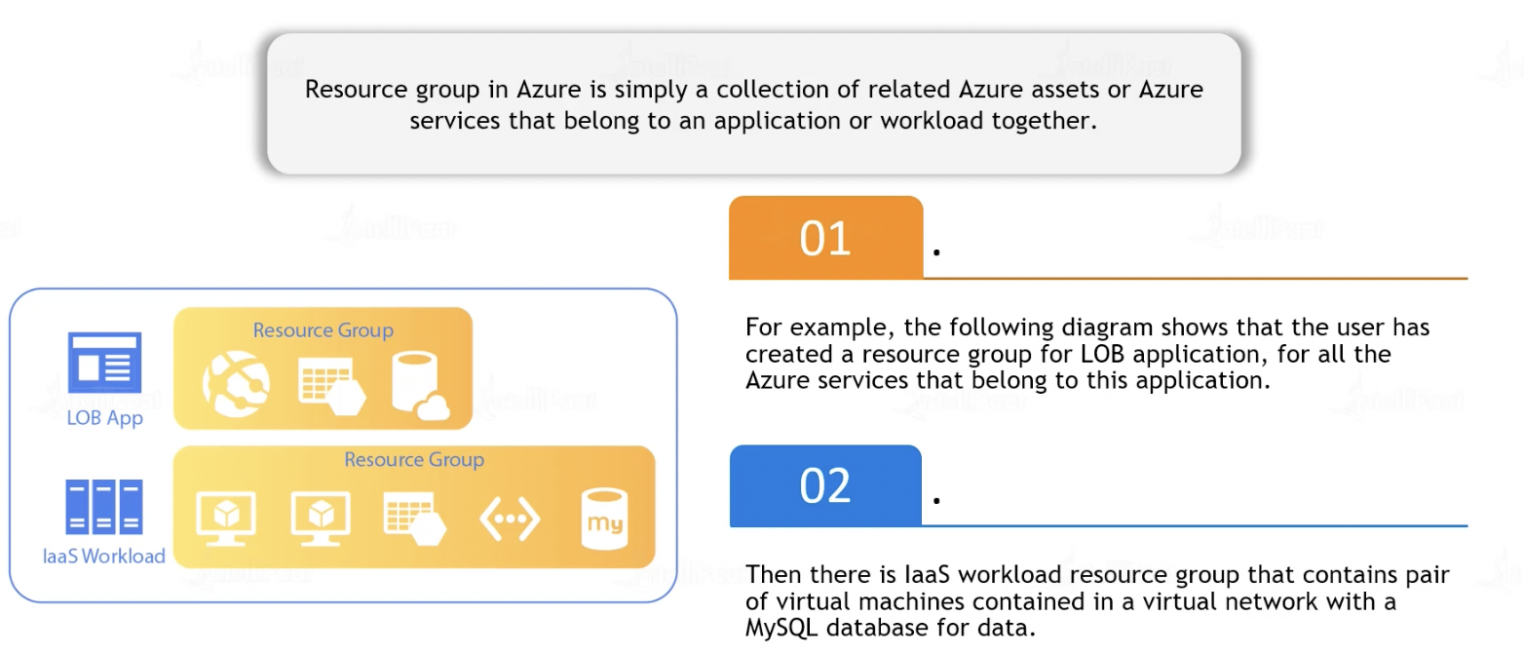
Resource Group
Created By : Abhishek Panda

Slide 4
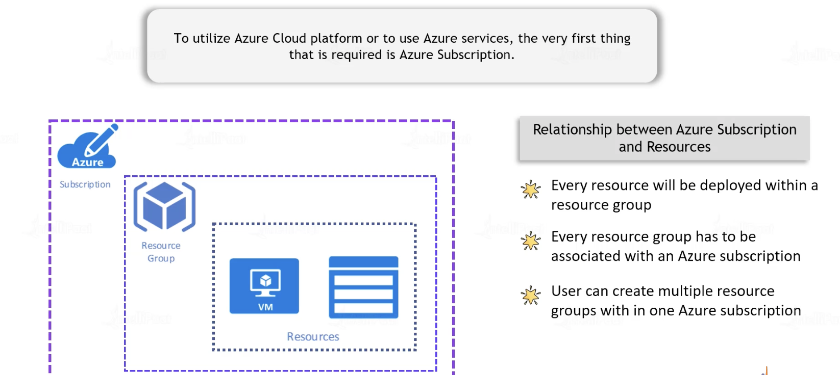
Azure Subscription & Resources
Created By : Abhishek Panda

Slide 5
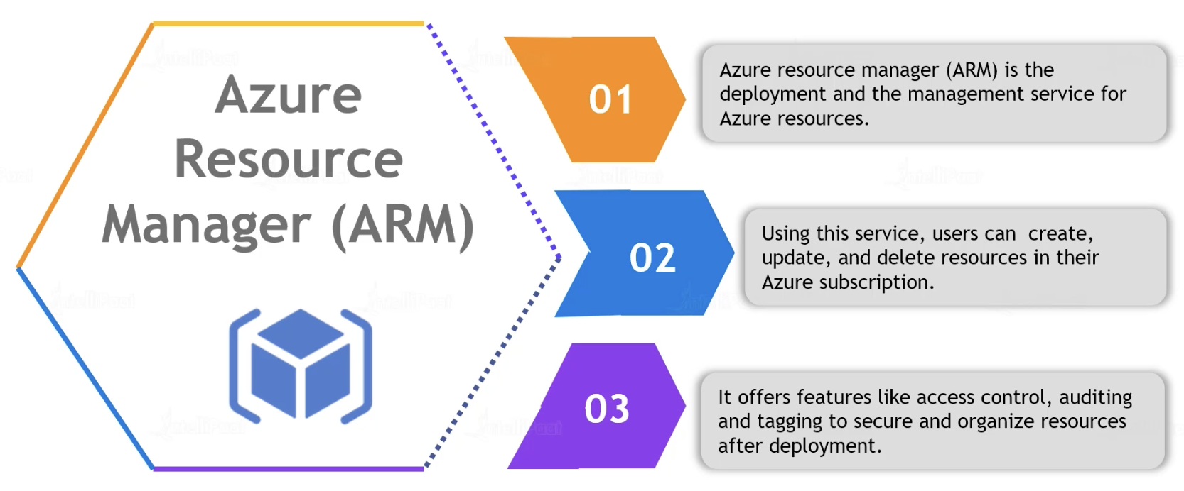
ARM(Azure Resource Manager)
Created By : Abhishek Panda

Slide 6
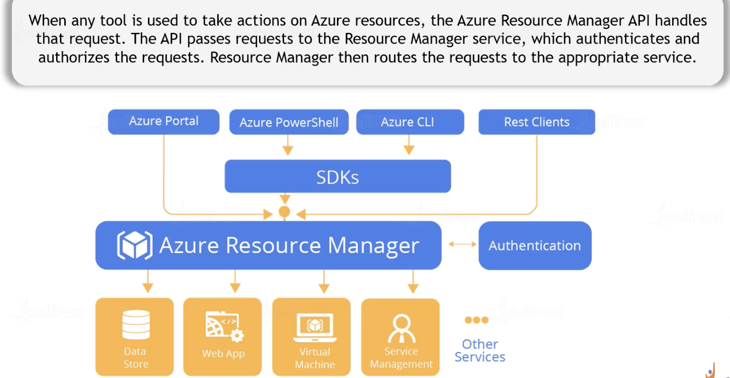
ARM(Azure Resource Manager)
Created By : Abhishek Panda

